Slide 1

AJAX Patterns
Submission Throttling
Aruna S
Department of
Computer Science and Engineering

Slide 2

AJAX PATTERNS
Submission Throttling
S. Aruna
Department of Computer Science and Engineering

Slide 3
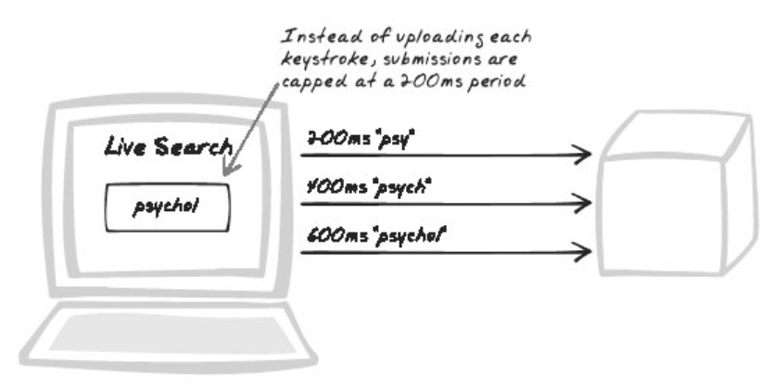
AJAX Patterns
Submission Throttling
Buffer, Queue, Performance, Throttle

Slide 4
AJAX Patterns
Submission Throttling Buffering Styles
The content which buffer holds is application-specific, but there are two general styles:
Data buffers and
Command queues.

Slide 5
AJAX Patterns
Data Buffers
Google Suggest
An "onchange" listener to the text field and upload the buffer when each change occurs
Suggestion systems, and more generally Live Command-Lines, run a fixed-period timer
The result for the current text field is cached, and the cache can only change on fixed periods.

Slide 6
AJAX Patterns
Submission Throttling Decision Factors
How will the server deal with incoming commands? Will all commands still be valid?
How will buffer uploads be triggered?
How many buffers per browser application?
Ex: Blog reader might use three buffers in parallel:
A low priority queue :15 seconds.
A medium priority queue : 3 seconds.
A high priority text buffer : 0.2 seconds.
How long should the throttle period be?

Slide 7
AJAX Patterns
Submission Throttling Applications
Google Suggest
Amazon Zuggest
Gmail
Prototype Framework

Slide 8
THANK YOU
Aruna S
Department of
Computer Science and Engineering
arunas@pes.edu

